Slide 1
udirect

Slide 2
What is udirect?
u.direct provides degree roadmaps that define a clear and timely path to graduation for every program of study. In consultation with advisors, students can use these roadmaps to build their own academic plans, helping them to stay on track to meet their educational goals. These roadmaps link curricula, course offerings, program requirements, pre-requisites, and course sequencing into a term-by-term plan. This approach ensures that students know to take the right course, in the right sequence, at the right time, for the right purpose—which saves them time and money. The creation of the term-by-term plans will also provide departments with the aggregate data needed for course demand and scheduling.

Slide 3
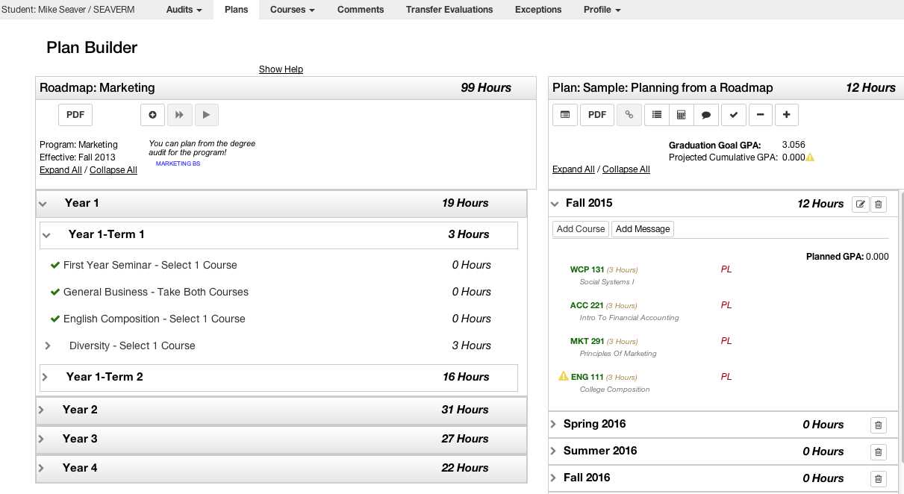
Students Build Academic Plans

Slide 4
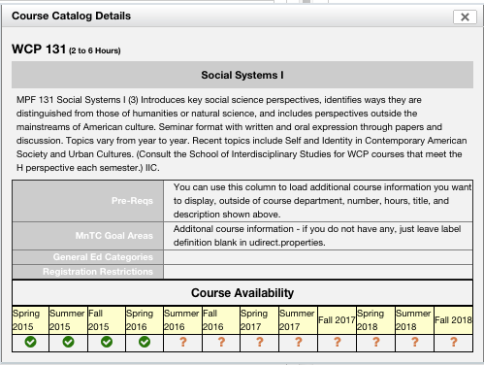
Access Detailed Course Information

Slide 5
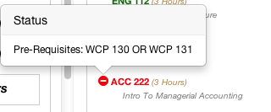
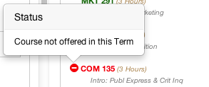
Warnings for Pre-reqs / Availability

Slide 6
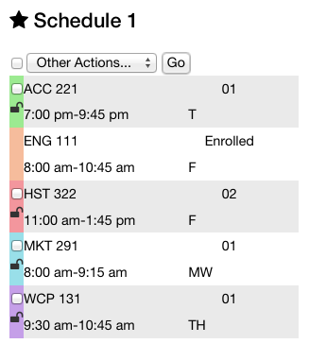
Create a Schedule for Registration

Slide 7
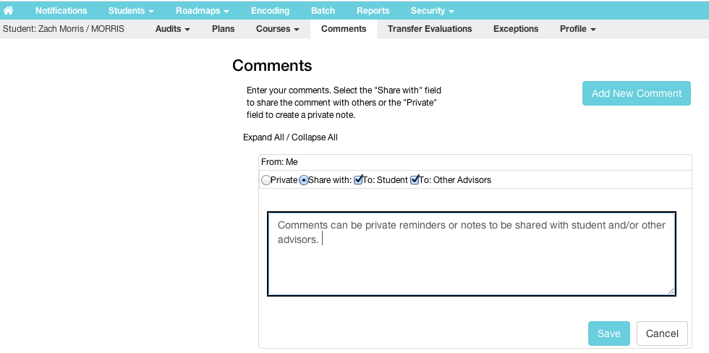
Advisors Approve & Comment

Slide 8
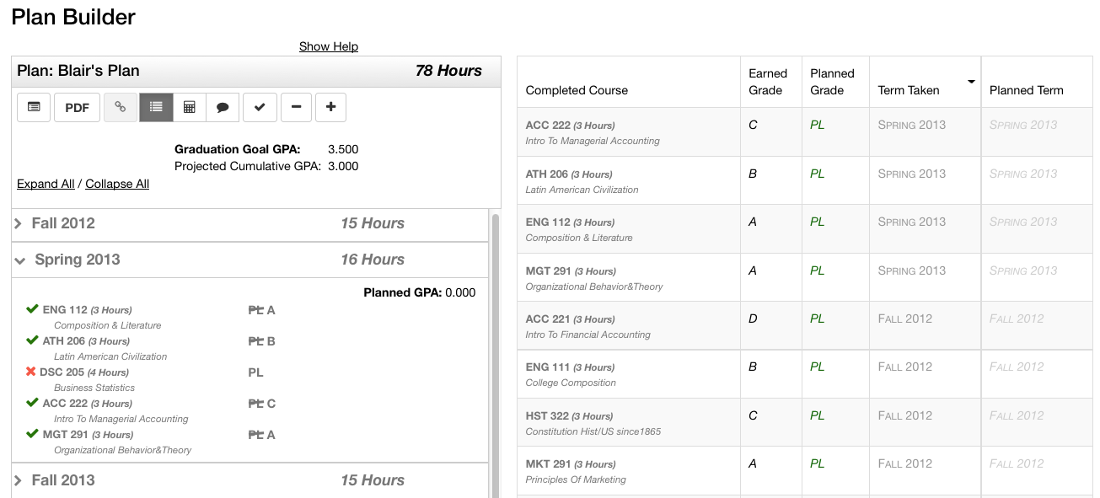
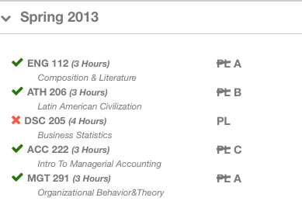
Plans Update as Students Progress

Slide 9
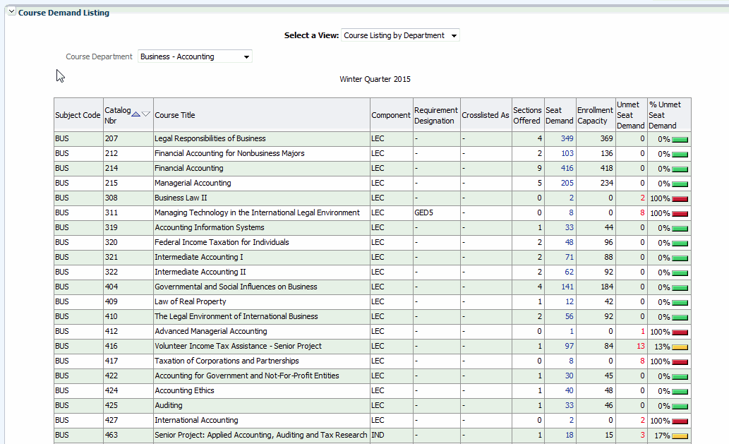
Roadmap Data Shows Course Demand

Slide 10
We have…
Assembled Cross Campus Evaluation Committee
Reviewed u.direct demonstrations & available documentation
Discussions and collaboration with other CSU’s
CSU Northridge
Cal Poly San Luis Obispo

Slide 11
Evaluation Committee
Kenneth Ayoob – Dean College of Arts Humanities and Social Sciences & Chair of Evaluation Committee
Lisa Castellino – Director of Institutional Research
Steven Hackett – Chair Economics Dept.
Vikash Lakhani – Associate Vice President of Enrollment Management
Cindy Moyer – Chair of Music dept. & Chair of Integrated Curriculum Committee
Dale Oliver – Professor Mathematics Dept.
Clint Rebik – University Registrar
Andrew Stubblefield – Associate Professor, Hydrology and Watershed Mgmt & Chair of Academic Policies Committee – University Senate
Kathy Thornhill – Director of Academic & Career Advising

Slide 12
Frequently Asked Questions…
Question | Answer
How will the course demand data be analyzed? By who? | TBD - likely a collaboration between ITS, IRP and functional groups
How will the demand data be used in planning which courses to offer when? | TBD - serve as a critical input to scheduling courses by term but does not guarantee course availability
Does planning a course in u.direct guarantee that the student will be able to get that course? | No.
Will advisors have to have both DARS (u.achieve) and u.direct open? | Both DARS (u.achieve) and u.direct exist in the same application. Advisors will not need to have two applications open at the same time.
Can advisors and others be notified if students are off track? | Yes.
Can a student modify their map after meeting with their advisor? | The software is neutral on this point. It can be implemented as mandatory, or optional or as a hybrid.
Are students required to completed a roadmap? | The software is neutral on this point. It can be implemented as mandatory, or optional or as a hybrid.

Slide 13
Frequently Asked Questions…
Question | Answer
Can the schedule builder in u.direct be used to replace the college scheduler product we have today? | Probably. We will do a side by side comparison before making a final recommendation.
Can students build a schedule with u.direct that integrates into PeopleSoft? | u.direct creates a schedule that the students can use to enroll in classes. It does not "automatically" enroll students.
Can alerts with u.direct be used with alerts from other advising systems like MAPworks? | Yes.
Will advisors be able to approve exceptions within the students map? How are exceptions entered into a student map/DARS? | The software allows for various options for entering exceptions based upon authorization level. It can be advisor, department chair or other.
How will students ask for approval of new maps? Can u.direct allow students to have advisors approve map changes? | The software allows changes to be emailed to student's advisors or whomever it is decided should authorize changes and be approved with changes automatically entered into the map
Will Department chairs still need to approve changes to maps? Who will have final approval of map changes and exceptions? | The software is neutral on this point and the authorization can be at any level agreed upon by policy.

Slide 14
Frequently Asked Questions…
Question | Answer
Need to be mindful that some students sign up for a class while taking the pre-req course. If they subsequently fail that pre-req course, is there a way for U-Direct to flag these students, or do we still need to do this manually after grades come out? | u.direct has some pre-req functionality, but it is limited. Warning message in the software can be used to guide students in planning.
Who can approve which plans? Academic advisors? Student advisors? | The software is neutral on this point and the authorization can be at any level agreed upon by policy.
What type of training is available for students? Academic advisors? | Training would be provided by on campus groups and by CollegeSource as appropriate
What type of support is available for students? Academic Advisors? (who provides that support?) | Support will be provided by on-campus resources and CollegeSource as appropriate
How will approvals of maps actually occur? | The software is neutral on this point and the authorization can be at any level agreed upon by policy.

Slide 15
Frequently Asked Questions…
Question | Answer
When a student moves a course from their roadmap to their course plan, will the course be colored "red" if the course is offered and fits the student's schedule, but is full? How do we accommodate wait-listing? Waitlists provide important information regarding whether another section should be offered. | No.
What will the maps look like and how interactive will they be? | Map information is drawn from the information already in DARS. The actual look and content of the maps is flexible and will be determined by the campus
Can roadmaps be built using requirements instead of courses? | No. u.direct requires that students build their plan from courses to allow for the collection of aggregate course data.
How much does u.direct cost | There is a Chancellor’s office grant for implementation and initial licensing (~$56k). After that, HSU will pay for annual software maintenance ($6k per year). Future license costs may be HSU responsibility depending on scope of contract and future services (~ $30k). If u.direct replaces college scheduler tool, will net $10k in maintenance savings per year.

Slide 16
We Need Your Input
What do you think?
What questions do you have?

